Slide 1
MINI PROJECT 4 : TIME SERIES Business Goal : To build a forecast model to predict the furniture sales of a certain store.
MAITRI NARANG DSFT 8

Slide 2
About Data :
The data contains 9994 records with no null values.
The data is stationary.

Slide 3
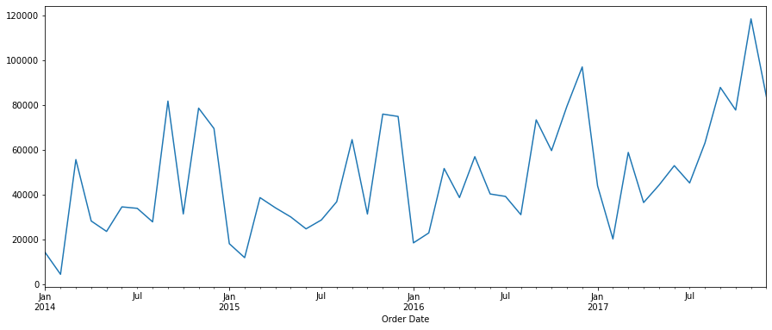
The original sales data over the years clearly indicates a seasonality pattern. The sales are always low at the beginning of the year and high at the end of the year.

Slide 4
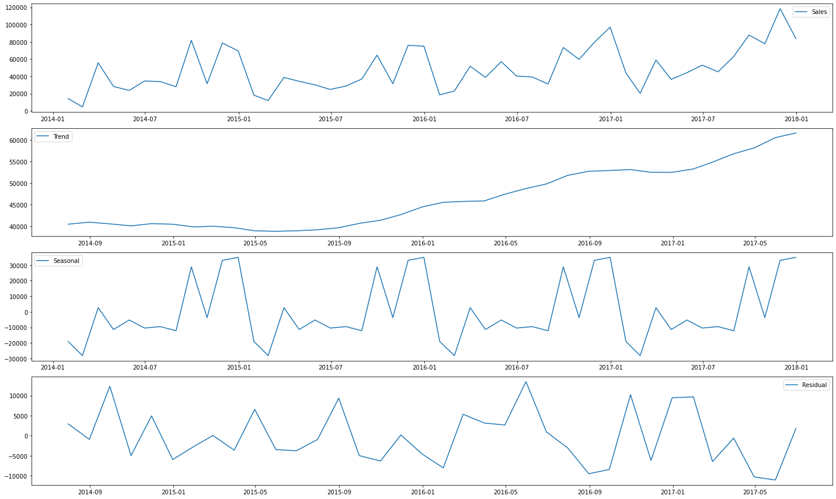
The sales are always low at the beginning of the year and high at the end of the year. There is always an upward trend within any single year with a couple of low months in the mid of the year. The overall trend over the years is increasing.
The sales pattern is seasonal and occurs every year at same time.

Slide 5
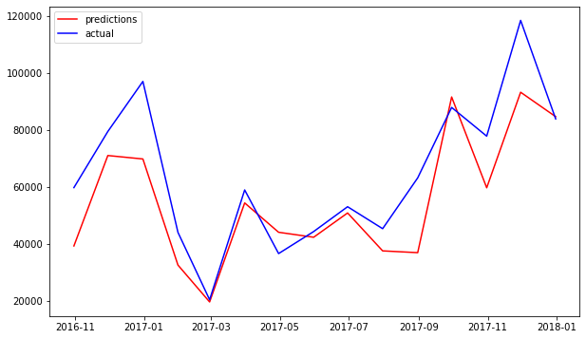
The finalized model SARIMAX model which took in account the most important factors of sales I.e profit and discount, and predicted the output. The plot shows the actual and forecasted values for some part of the data. Hence, this model is a good fit for predicting the furniture sales because of its low values for all error evaluation parameters and good performance as compared to other models.

Slide 6
THANKYOU

